Slide 1
CnPack IDE Wizards
—— CnPack Administrator:
Zhou Jingyu, Liu Xiao
2007.09.12

Slide 2
About CnPack Team
CnPack Team was Established in 2001 from Delphibbs.com
Objective: Develop the Tools, Packages and Plug-in Set based on Delphi/C++Builder
Members: Now About 240
Products: CnPack IDE Wizards, CnPack Component Package, CVSTracNT
Initiator : Zhou Jingyu
Administrator: Zhou Jingyu, Liu Xiao

Slide 3
About CnPack IDE Wizards
What is CnPack IDE Wizards?
CnPack IDE Wizards is a Free, Open-Source Plug-in Tools Set Used in Delphi / C++ Builder / BDS to Improve our Development Efficiency
The First version of CnPack IDE Wizards is Published in 2002

Slide 4
About CnPack IDE Wizards
Who can Use CnPack IDE Wizards?
CnPack IDE Wizards is Designed to Face the Programmers who Use Delphi 5 6 7 8 2007, C++Builder 5 6 or BDS 2005 2006
The Official Version of CnPack IDE Wizards Includes 3 Languages: Simplified Chinese, Traditional Chinese and English

Slide 5
CnPack IDE Wizards Introduction
Current Version of CnPack IDE Wizards: 0.8.2
Zhou Jingyu, the Initiator, Administrator, Main Designer and Author of CnPack IDE Wizards is Elected as an Borland Expert in 2003
Users Cover Home and Aboard. CnPack IDE Users are More than 4300 by Upgrade-checking Statistics.

Slide 6
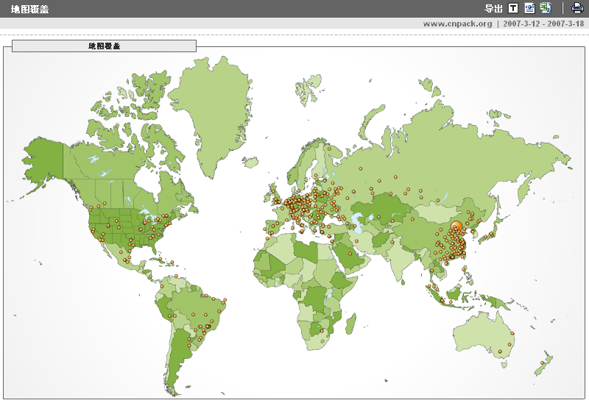
CnPack IDE Wizards Users

Slide 7
Background of CnPack IDE Wizards
Borland Delphi/C++Builder are Famous RAD Development Tools
Borland Provides Open Tools API in IDE as an Open Plug-in Architecture
There’re Similar Foreign Tools, such as GExperts, CodeRush, Castalia, ModelMaker
NO Free Wizards with Chinese UI/Style
So, We Develop CnPack IDE Wizards

Slide 8
CnPack IDE Wizards License
It’s “CnPack IDE Wizards License”
Derived from the Official Open Source Definition
NO Commercial Usage of CnPack IDE Wizards Source Code without CnPack Team's Formal Authorization
This License should be Attached
NO Express or Implied Warranties
Accept NO Liability for any Result

Slide 9
Characteristic of CnPack IDE Wizards
3 UI Languages for Users at Home and Abroad
Powerful and Creative. Some Features, such as Input Helper, are Originality
Some Chinese-Style Features Make up of Similar Foreign Products for Chinese Users
Some Components, Libraries and Debugging Tools are Attached for Developers
Free, Open Source. Open Architecture for Customization Development

Slide 10
CnPack IDE Wizards Internals
A Mini Framework with Wizards Management and Registration Mechanism
Encapsulation to Open Tools API and IDE Services
Dynamic Enabled/Disabled for Separate Features
Unified Base Classes and Debugging Output Interfaces
Dynamic Switching Support of Multi-Language UI
About 100 thousand Lines of Source Code

Slide 11
CnPack Team Structure
By Responsibility:
Project Administrator, CVS Inspector
Developer, Tester, Document Writer
Communication Administrator: Mailing List, BBS, QQ Group
By Level:
Administrator: Project Manager and Team Manager
VIP Member: Main Developer and Tester
Common Member: Code Donator, Document Writer and Tester

Slide 12
CnPack Project Management Tools
Development Platform: Redsaga
Mirrors: Cosoft, SourceForge
Version Control: CVS
Task Management and Bug-Track Tool: Web-based CVSTrac
Nightly-Build: want

Slide 13
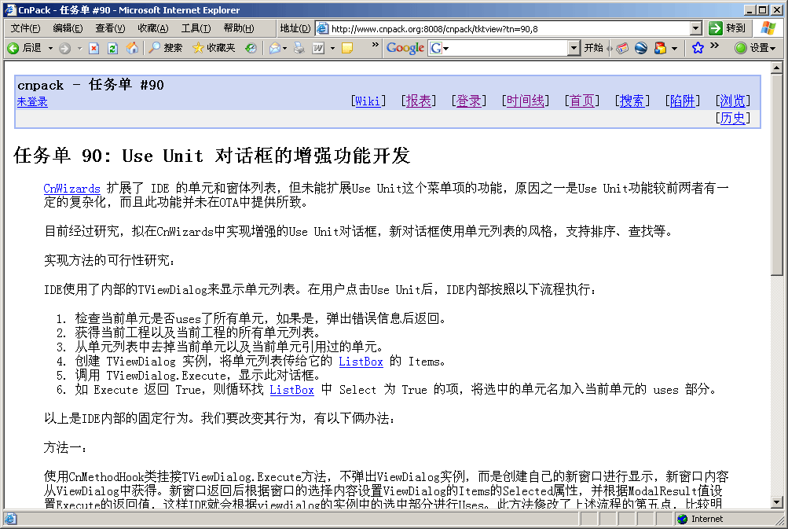
CVSTrac Ticket (Chinese)

Slide 14
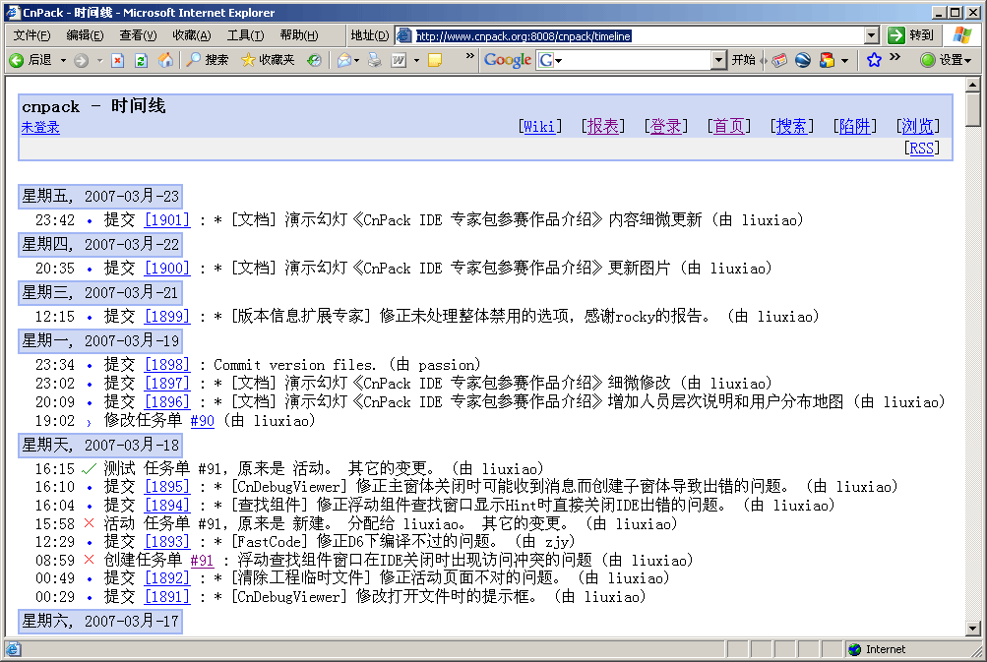
CVSTrac Timeline (Chinese)

Slide 15
CnPack’s Future
Product: CnPack IDE Wizards:
Improve Pascal Script, Provide More Functions
Support to C++Builder 2007
New Features and Bug-Fixing
Plan for .NET or Java IDE (Eclipse) Plug-in Set
Community Building: CnPack Community for Communications of Users and Developers
CnPack Team Building

Slide 16
CnPack IDE Wizards Demo
Demo Version: CnWizards 0.8.2 RC
Pascal Script Support
Customization Build (DIY)
Demo Environment.: Borland Delphi 7
Demo Content: Code Input Helper, Designer/Editor Toolbar, Unit/Form List, Multi-Language, Wizards Settings, Pascal Script, Source Statistics, Customization Build

Slide 17
Thank You!
Q & A
https://www.cnpack.org
master@cnpack.org

